Slide 1

Mobile Game dev.
By: Mikhael

Slide 2
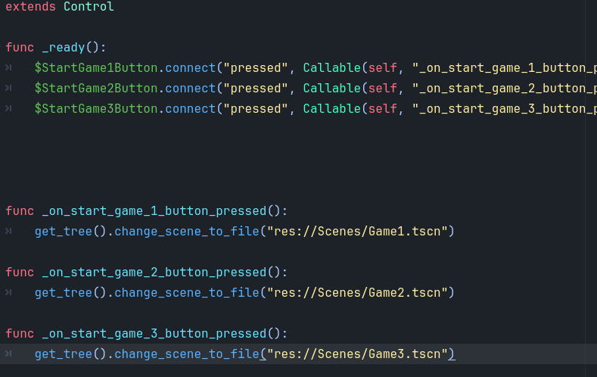
Main Menu
The purpose of the main menu is to be able to choose 1 of the 3 games that the player wants to play

Slide 3
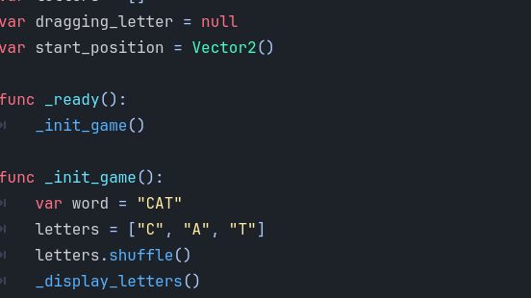
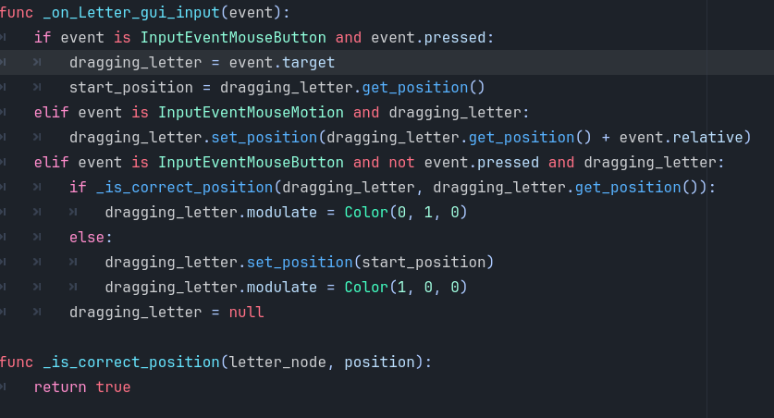
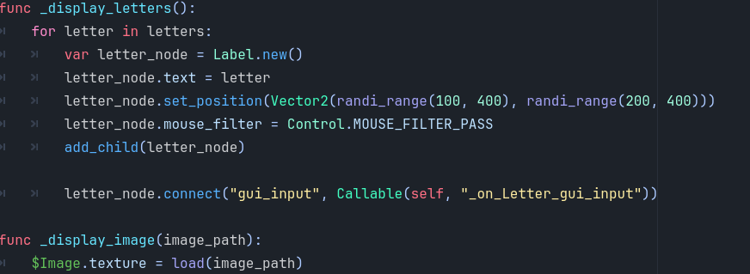
Match and learn
In this game I needed to create a game where the player sees a picture and tries to match the letters with the word of the image

Slide 4
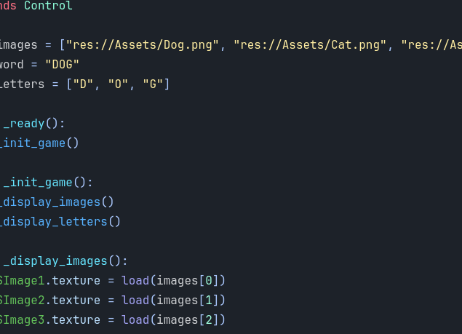
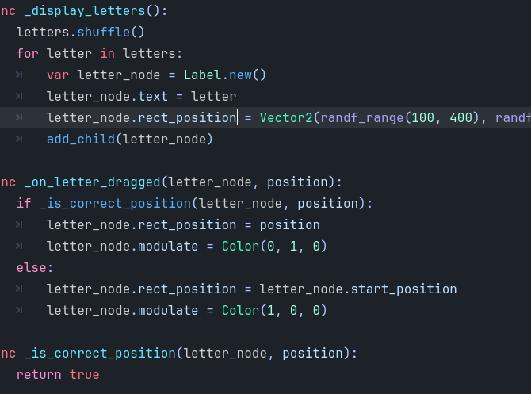
3 Pics 1 Word
Here I needed to create the same game as the previous slide but with 3 different images of the same object
I did this by creating 3 variables for the images and put the words of said images into a container, when the images are changed so is the word that needs to be guessed corresponding with the image

Slide 5
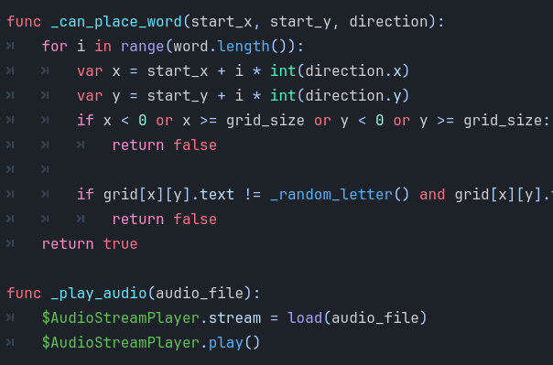
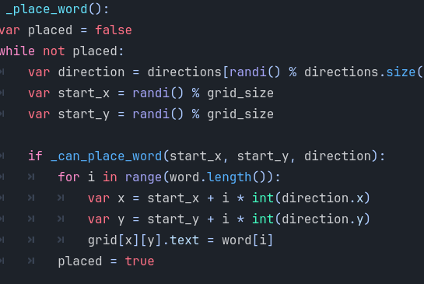
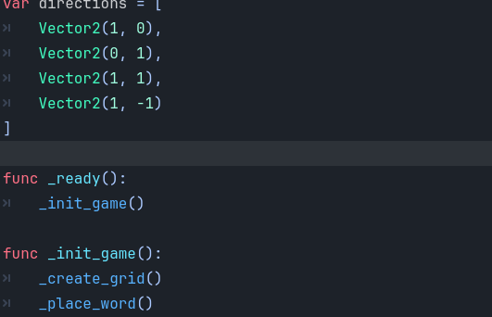
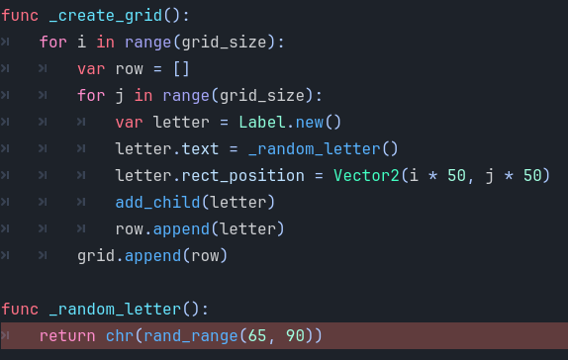
Find the word

Slide 6
‘Hey That’s my fish’

Slide 7

Problems
-

